Slide 1
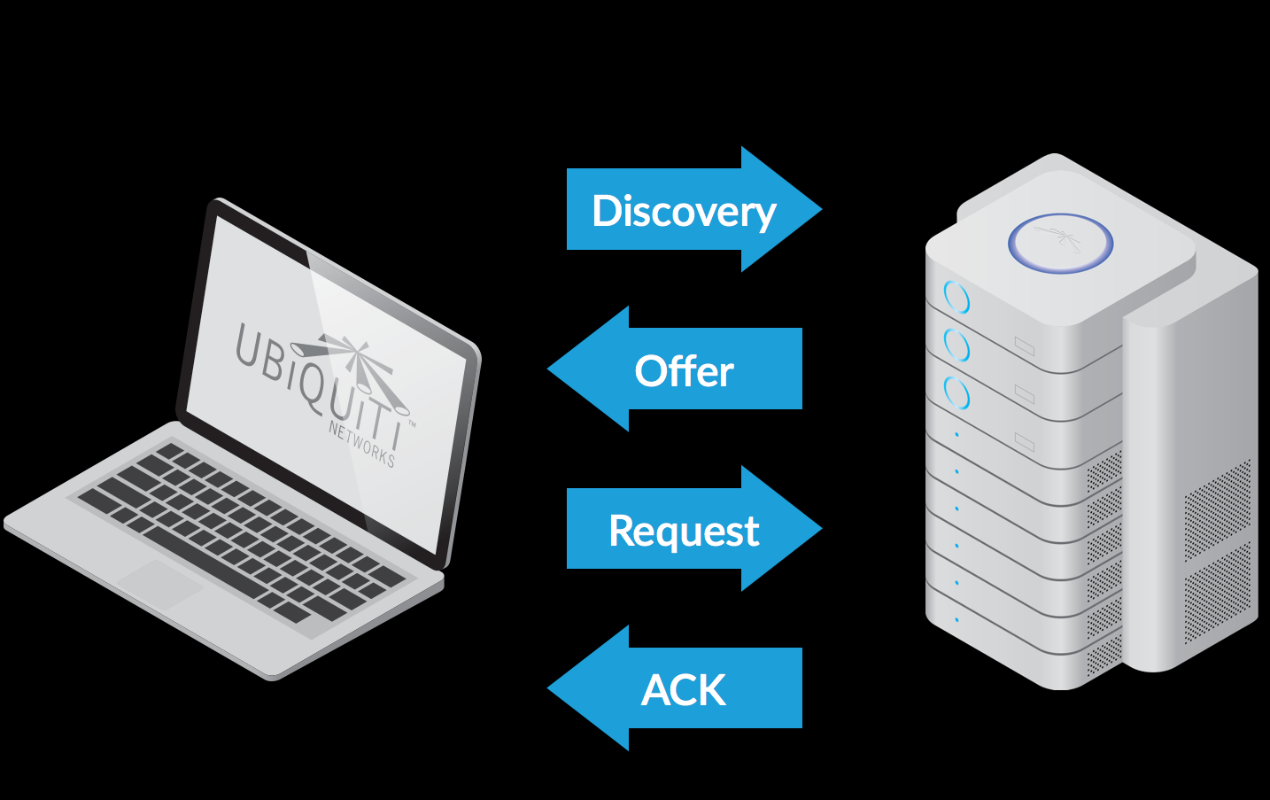
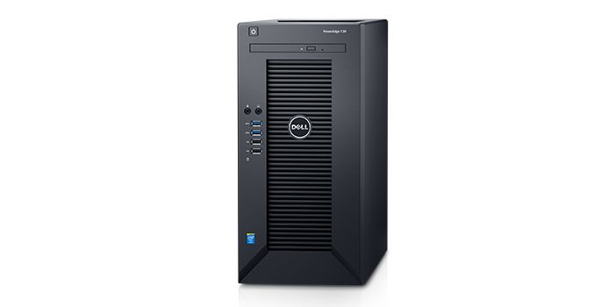
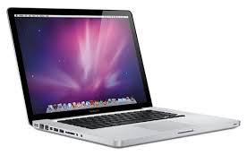
DHCP
Used to dynamically assign an IP address to any node
ADVANTAGES
TECHNOLOGIES PRIOR TO DHCP
STEP BY STEP PROCESS
DISCOVERY
OFFER
REQUEST
ACKNOWLEDGE

Slide 2
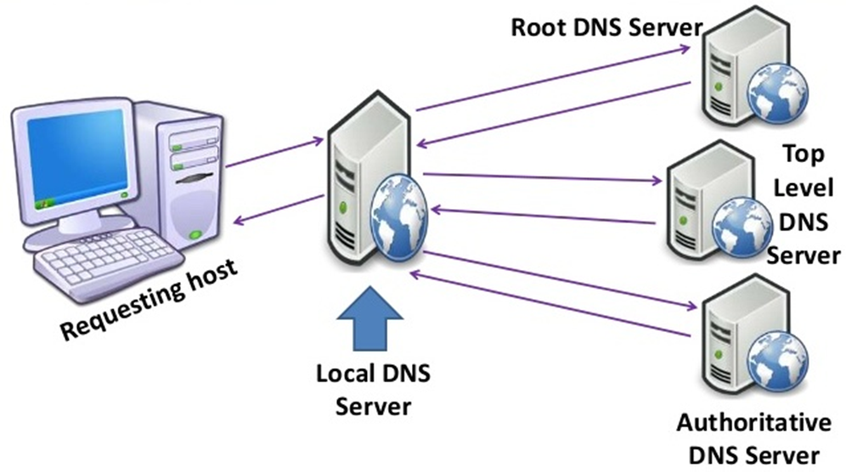
DNS
The Domain Name System (DNS) is a hierarchical decentralized naming system for computers, services, or other resources connected to the Internet or a private network.

Slide 3
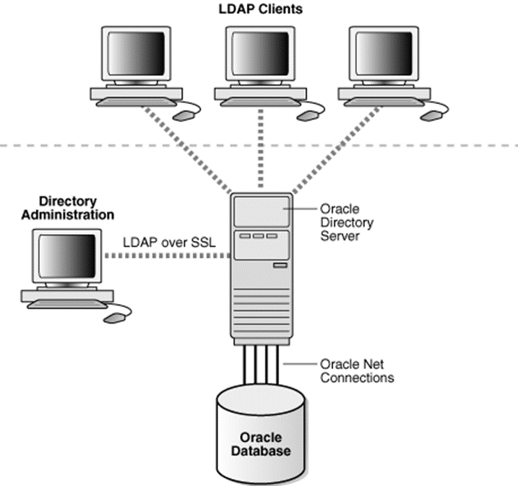
DIRECTORY SERVICES
Directory services contain data and metadata
X.500 formed the basis of a standard that is widely deployed known as LDAP

Slide 4
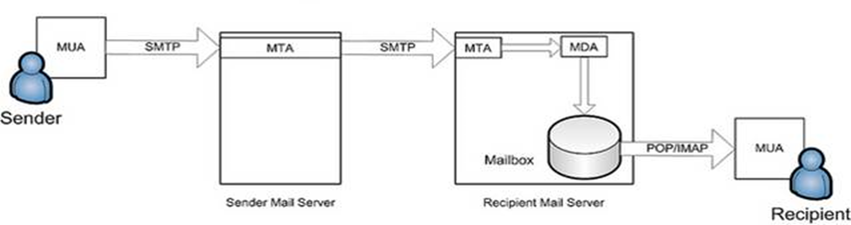
MAIL SERVICES
An application that receives incoming e-mail from local users and remote senders and forwards outgoing e-mail for delivery.
MTA
MUA
LDP
SMTP
POP3
IMAP4
MAPI

Slide 5
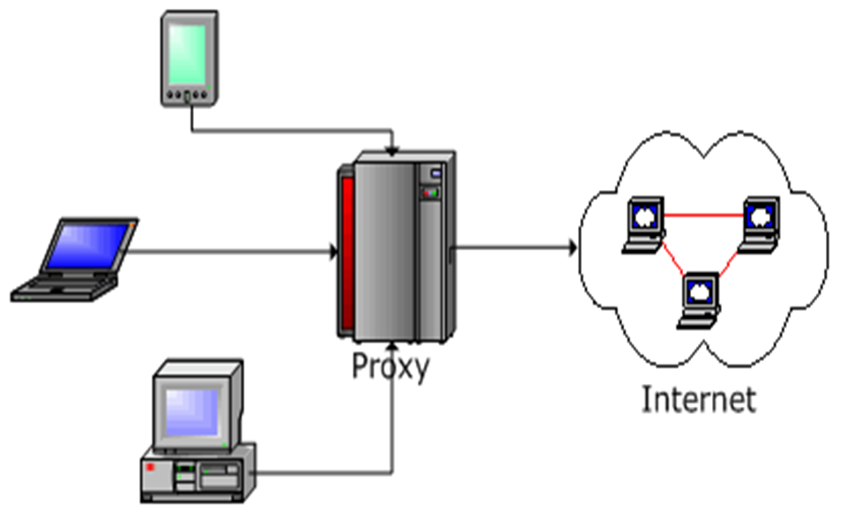
PROXY SERVICES
Acts as an intermediary between the user's computer and the Internet
Proxy caching is a feature of proxy servers that stores content on the proxy server itself, allowing web services to share those resources to more users.

Slide 6
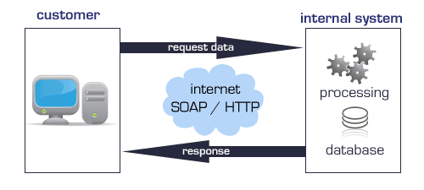
WEB SERVICES
It’s a service offered by an electronic device to another electronic device, communicating with each other via the World Wide Web.

Slide 7
APPLICATIONS
An application program is a computer program designed to perform a group of coordinated functions, tasks, or activities for the benefit of the user.
PRESENTATION LAYER
BUSINESS LOGIC LAYER
DATA ACCESS LAYER
COMPONENTS
COMPILER
INTERPRETER
TYPES:

Slide 8
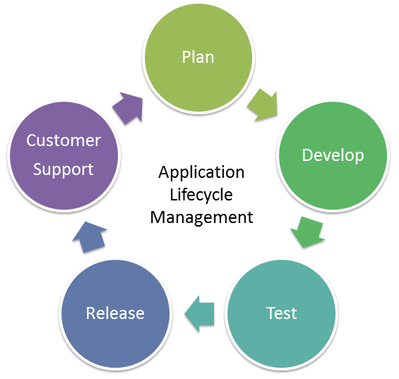
APPLICATIONS - LIFE CYCLE

Slide 9
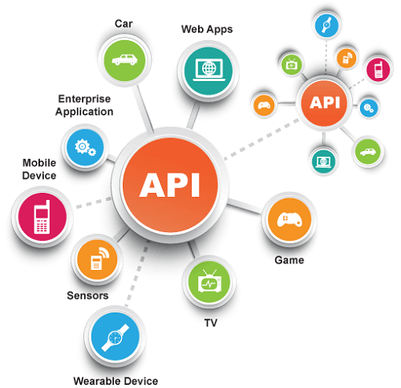
API
An application program interface (API) is code that allows two software programs to communicate with each other.
TYPES OF ATTACKS:
SQL injection
cross-site scripting
Denial-of-service
Session hijacking

Slide 10
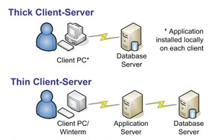
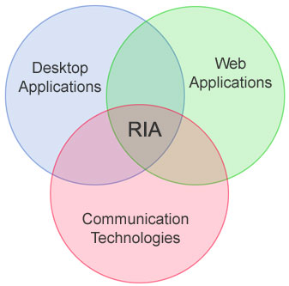
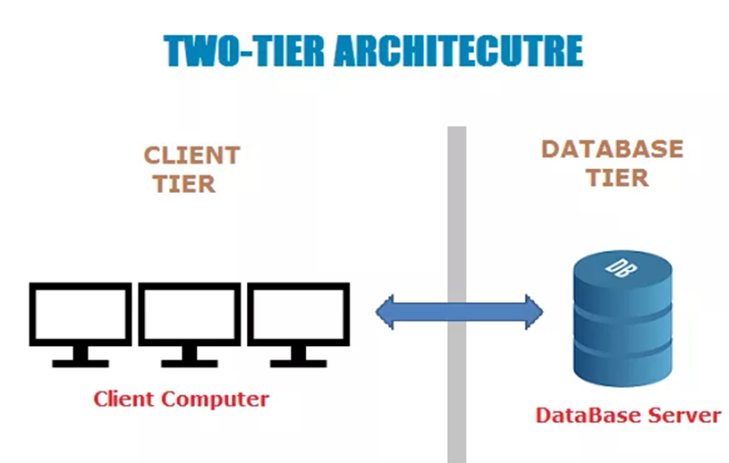
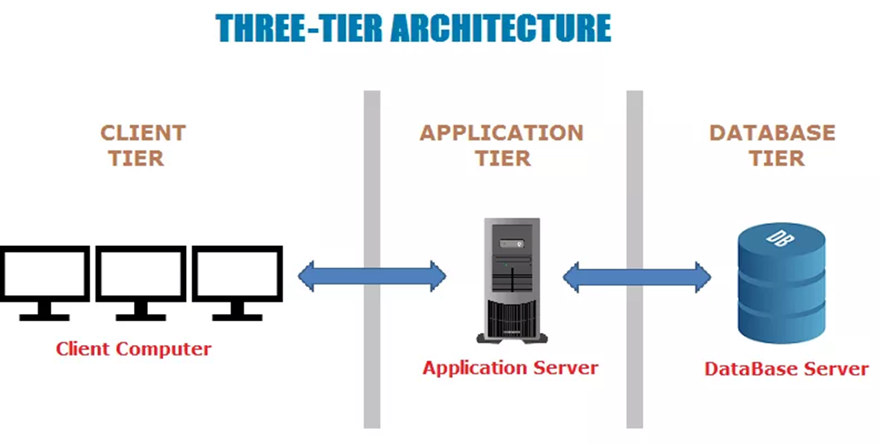
APPLICATION ARCHITECTURE - TYPES

Slide 11
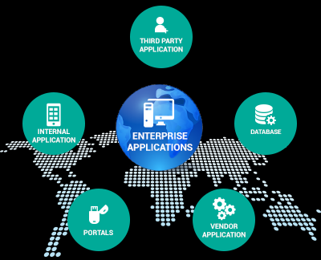
ENTERPRISE APPLICATIONS

